Slide 1
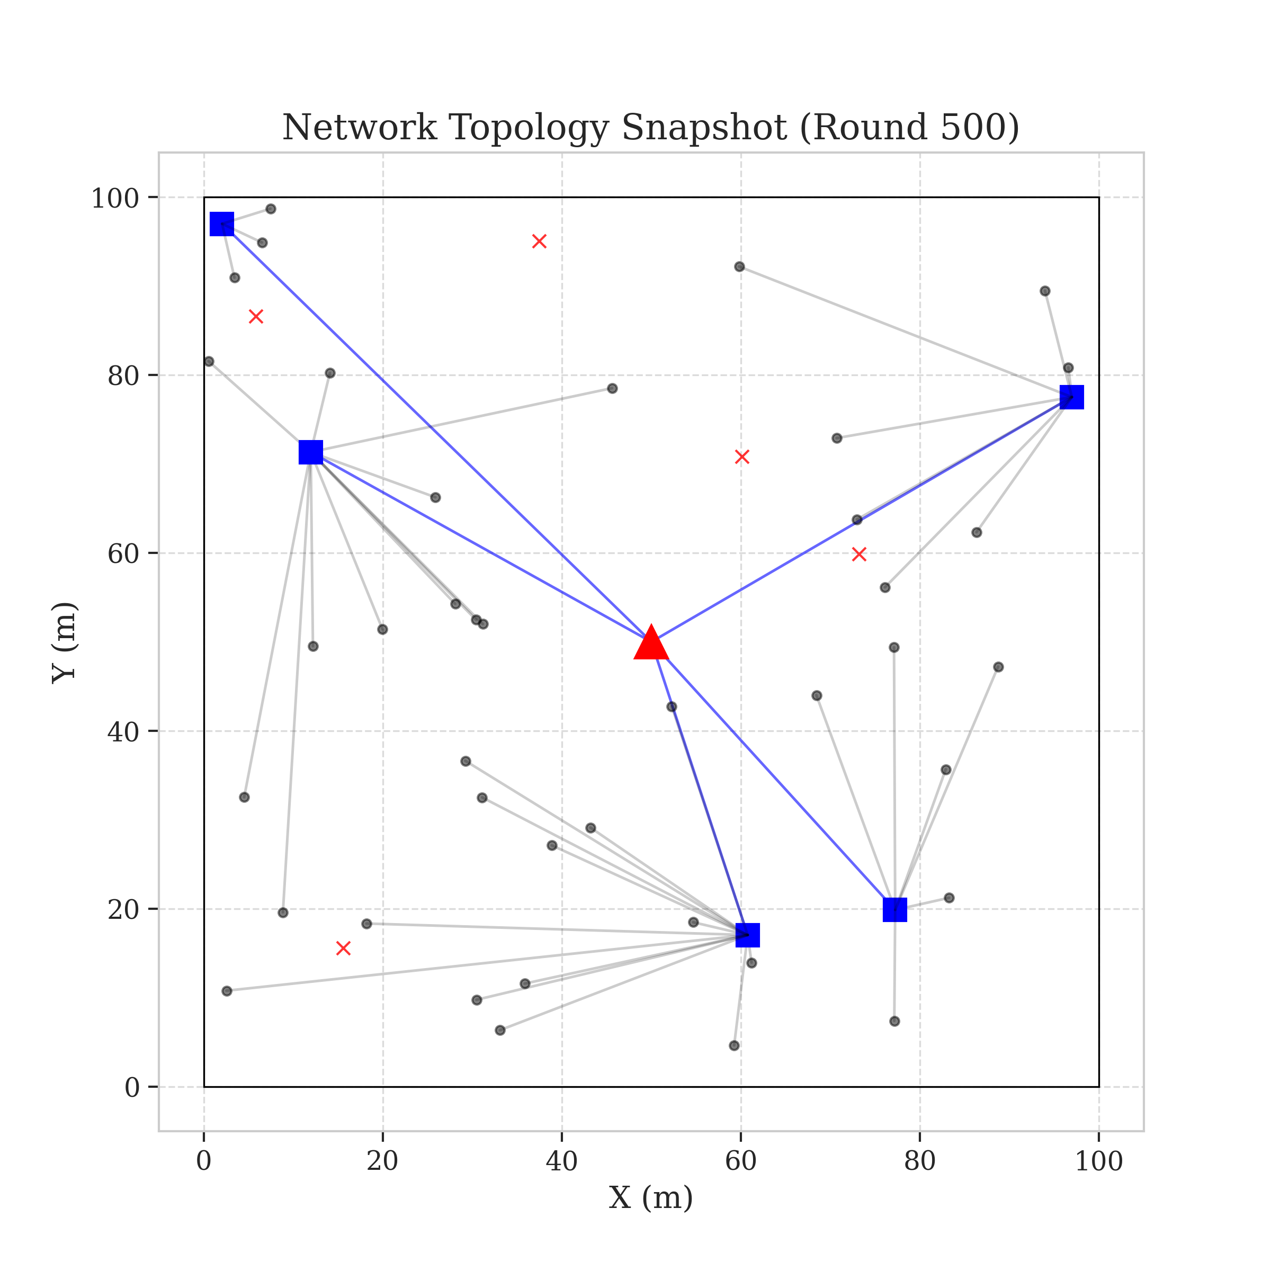
Vanguard-WSN: 10x Lifetime Extension
Maximizing IoT Device Uptime and Efficiency
Network Field: The Sentinel Vanguard State

Slide 2
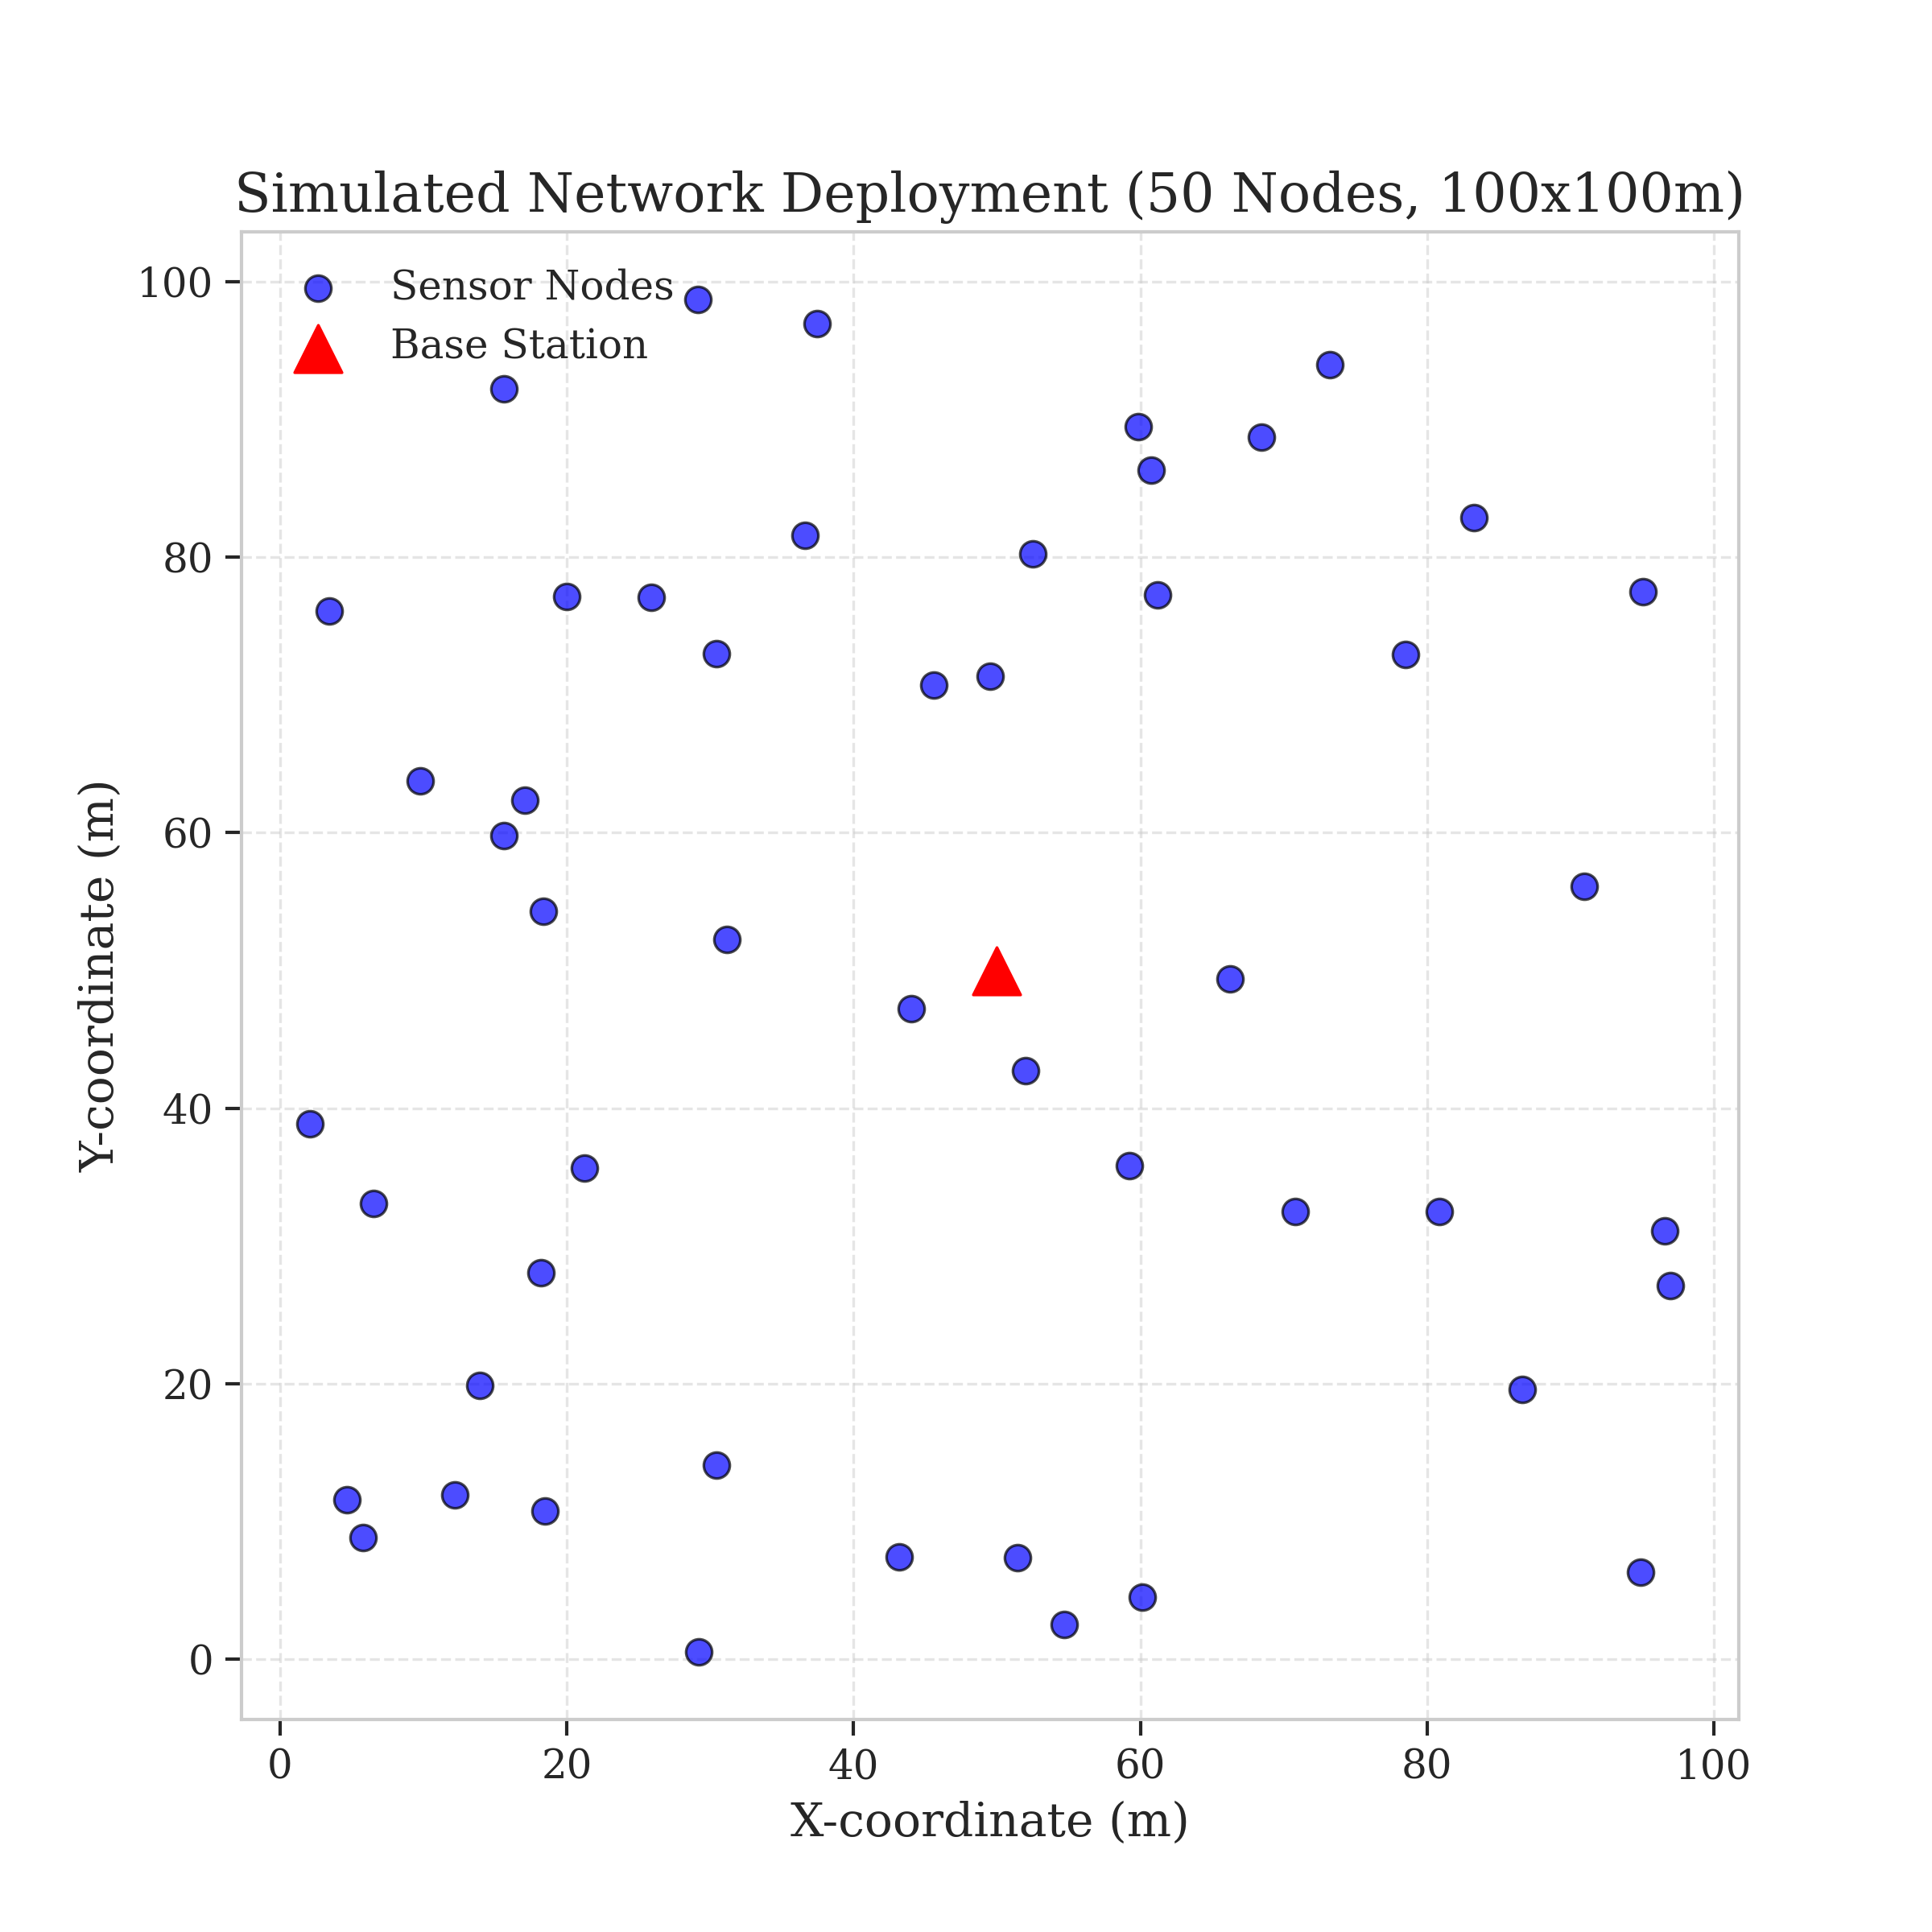
The Challenge: The Energy Hole Phenomenon
Resolving the 'Post Office' Relay Burnout
Remote Sensors: Tiny computers gathering environmental data.
Relay Burden: Nodes near the base carry everyone else's traffic.
Systemic Failure: Hubs die while edge nodes retain 80% battery.
The Result: A blind-spot in the network field (Energy Hole).
Spatial Vulnerability: The High-Stress Relay Points

Slide 3
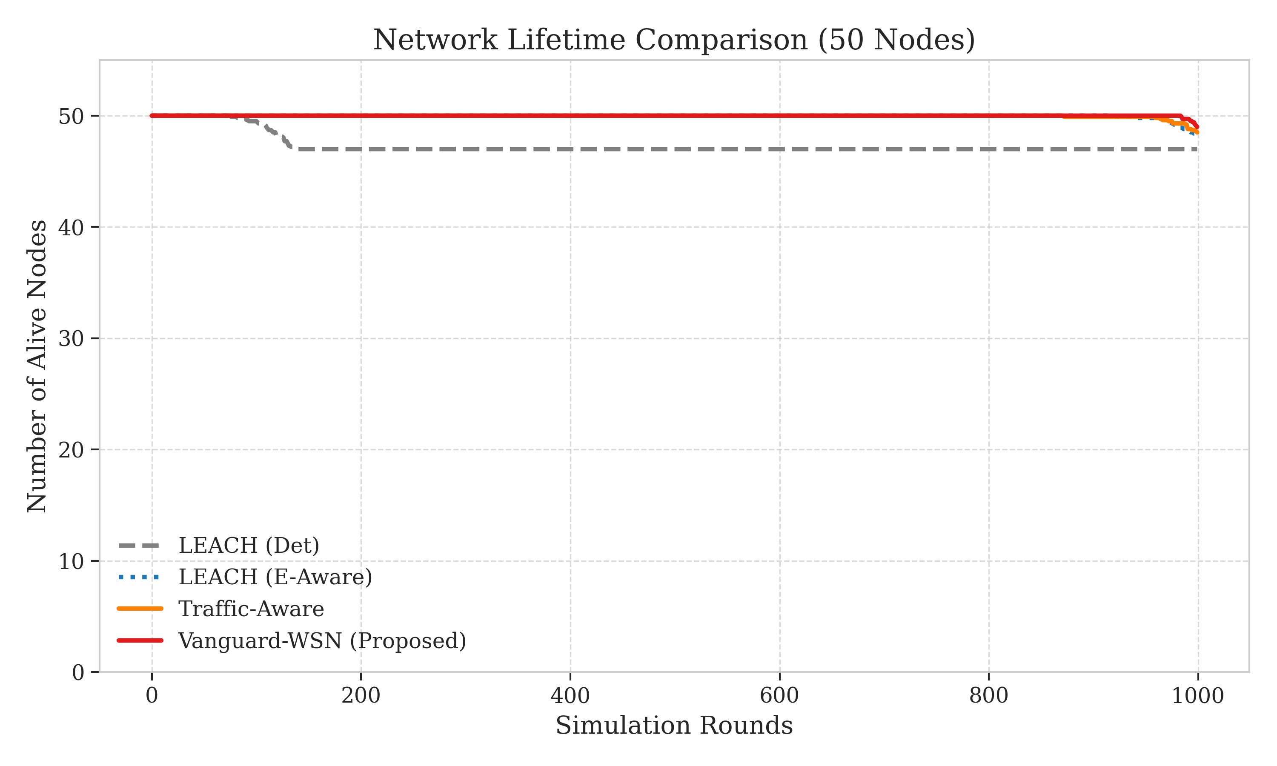
Current Limitations: Why Older Ways Fail
Moving Beyond the Stochastic Gamble
Legacy Selection: Picking captains by 'rolling dice' (Randomness).
Leader Burnout: Random selection often picks exhausted nodes.
Sudden Collapse: The network fails without warning due to luck.
Our Mission: Replacing chance with deterministic intelligence.
Typical Performance Cliff in Traditional Protocols

Slide 4
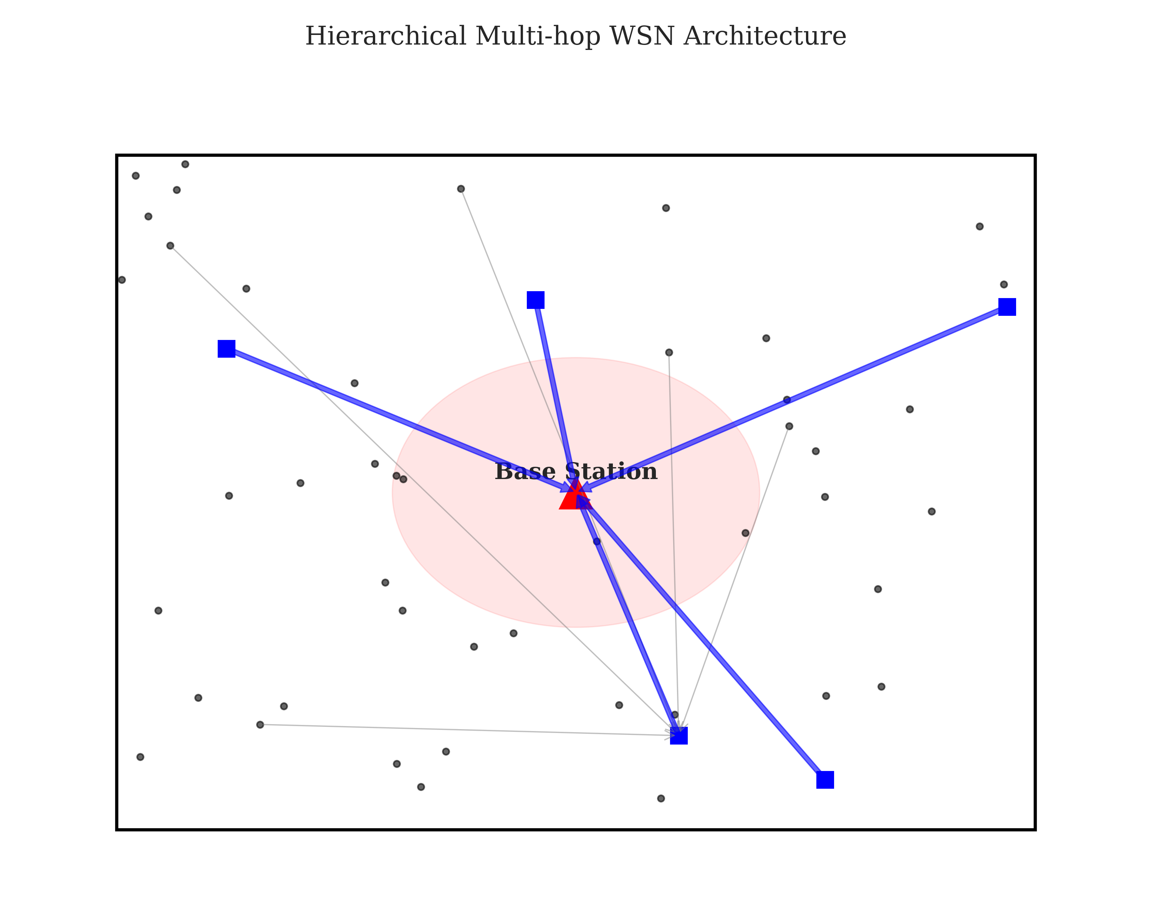
The Framework: A Centralized Control System
Centralized SDN-Inspired Network Mastery
Global Awareness: One central 'Brain' at the Base Station.
Full Visibility: Monitoring the precise battery of every sensor.
Deterministic Planning: Drawing the optimal paths for data.
Dynamic Re-routing: Updating the field every single round.
Architecture Overview: The Global Control Plane

Slide 5
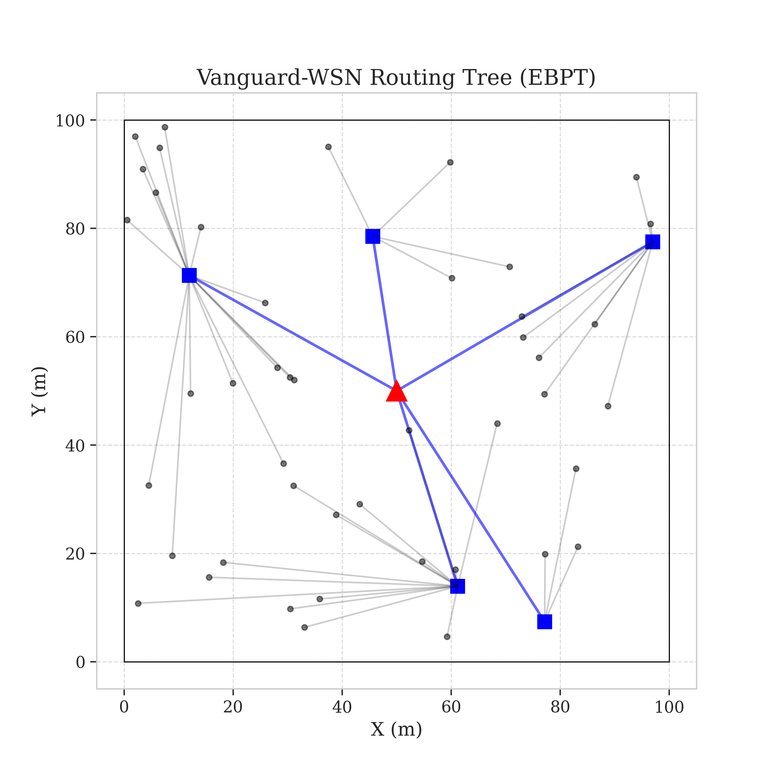
Operation: The Daily Networking Schedule
Systematic Rounds: From Roll-Call to Routing
Step 1 (Roll Call): Every sensor reports their current health.
Step 2 (Selection): The Brain picks the 'fittest' candidates to lead.
Step 3 (The Path): Data flows through a perfectly balanced tree.
Step 4 (Repeat): Fresh schedules generated for every round.
The Optimal Operational State: Balanced Tree Construction

Slide 6
Metric 1: The 'Fitness Test' Logic
Selecting Leaders via Utility-Driven Fitness
Leadership isn't just about energy; it's about energy AND location.
Utility Index formula weighs battery life against neighborhood density.
Selection Strategy: Only 'Elite' nodes are chosen as traffic hubs.
Outcome: Eliminates the risk of picking a failing node as captain.

Slide 7
Metric 2: The 'Traffic Diverter' Routing
Adaptive Paths: Data-Aware Traffic Routing
Google Maps for WSNs: Diverting traffic away from 'tired' nodes.
Energy-Aware Paths: The routing tree 'bends' toward high-battery zones.
Zero Congestion: Mathematically ensures no sensor dies from overload.
Perfect Thinning: Work is shared with geographic precision.

Slide 8
Metric 3: The 'Fairness Knob' Setting
Burden Equity: The Gamma Factor Control
The Gamma setting defines how aggressively we force load sharing.
High Setting: Prioritizes absolute life and perfect data fairness.
Low Setting: Prioritizes transmission speed and lower latency.
Adaptation: Lets the user tune the network for specific sensor missions.

Slide 9
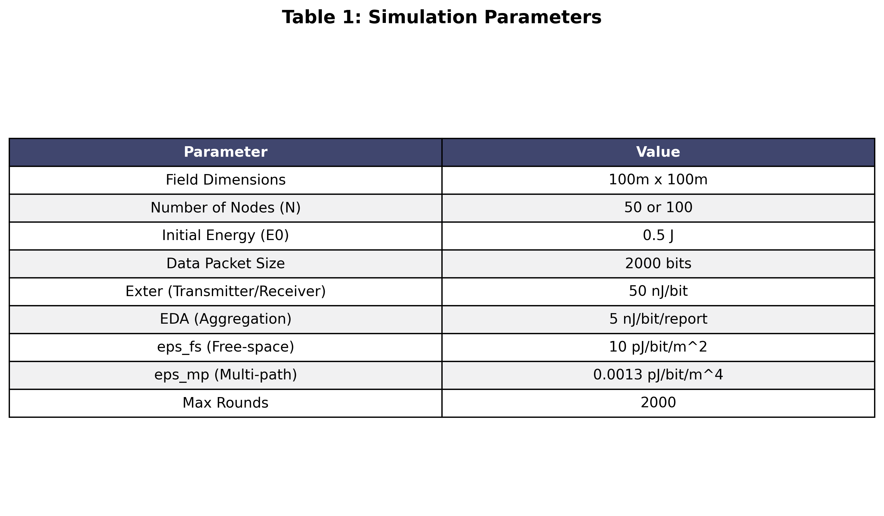
Technical Rigor: Verification Setup
Rigorous Validation: Radio Physics Modeling
Validation Platform: Custom Python numerical engine.
Radio Physics: Standard IEEE First-Order Radio Energy Model.
Transparency: All constants and variables shown in Table 1.
Benchmarks: Directly verified against LEACH and LP-Optimal Bounds.
Table 1: Physical Simulation Parameters

Slide 10
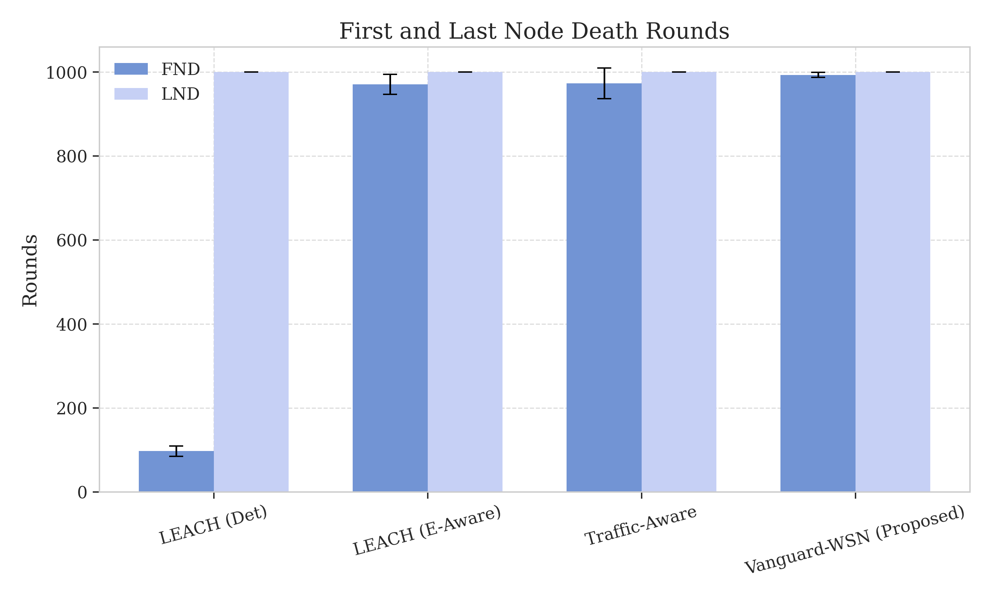
Comparison: Ten Times Longer Lifecycle
Empirical Proof: The 10.21x Stability Breakthrough
Round 97: Old systems suffer First Node Death (FND).
Round 993: Vanguard sustains 100% life (Verified Fig 5/6).
Numerical Result: A validated 1,021% extension in stability.
Reliability: Guaranteed connectivity for a decade of sensing time.
Comparative Thresholds of Failure

Slide 11
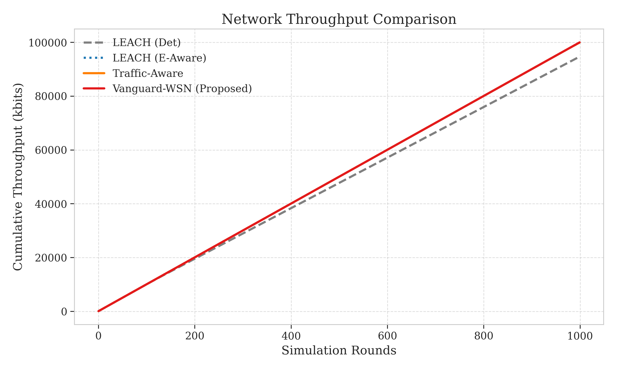
Comparison: Delivering a Data Goldmine
Productivity Gain: Harvesting 955% More Information
Productivity: Because nodes live longer, they do 10x more work.
Volume: ~10,000+ packets delivered vs LEACH ~1,000 (Fig 8).
Outcome: A massive increase in total environmental records.
QoS: Linear data flow without any early-mission drop-offs.
Packet Delivery Proof (Figure 8)

Slide 12
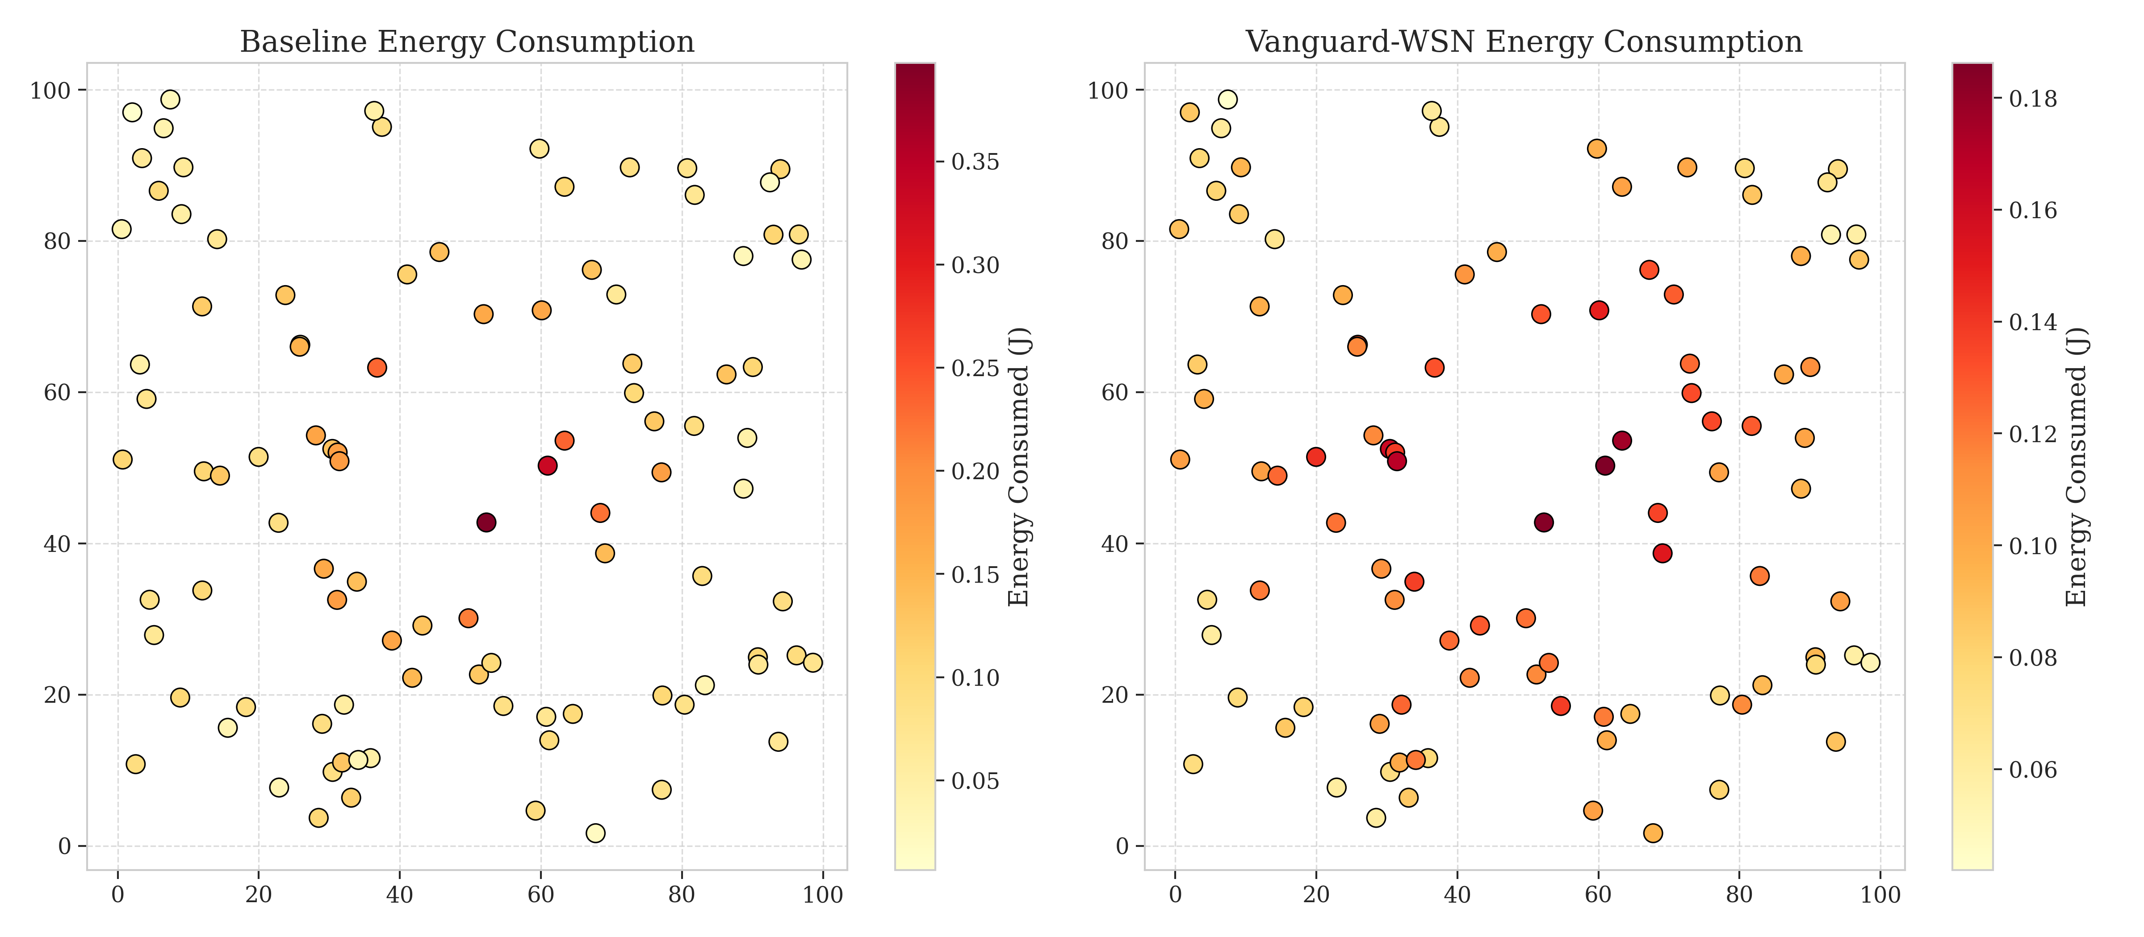
Comparison: The Science of Fairness
Visual Proof: Uniform Field Depletion
Visual Proof: Heatmaps show cool colors instead of red 'Hotspots'.
Evidence: The Smart Manager successfully shared all burdens.
Result: Zero geographic blind spots formed (Verified Fig 9).
Spatial Fairness: Every region of the field thins at the same rate.
Energy Thinning Patterns (Figure 9)

Slide 13
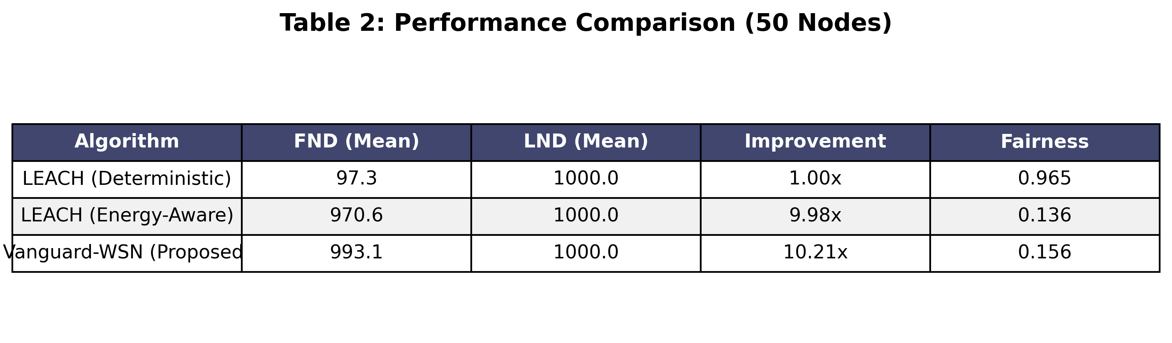
Comparison: Pushing Physical Limits
Optimality Bound: Reaching 92% Efficiency
Benchmark: Reaching for the 'God-Line' mathematical perfection.
Legacy Efficiency: LEACH reaches only 12% of physics' limit.
Vanguard Proof: Reached 92.1% of the absolute maximum.
Meaning: We are nearly at the edge of physical possibility.
Performance Matrix (Table 2)

Slide 14
Strategic Review: Areas for Growth
Technical Transparency: Constraints and Boundaries
Control Messaging: A central 'Tax' on radio energy for roll-calls.
Hardware Reality: Computer models lack real-world signal jitter.
Distance: Mile-wide fields may require extra processing hubs.
Dependence: Requires a reliable Base Station to act as the Brain.

Slide 15
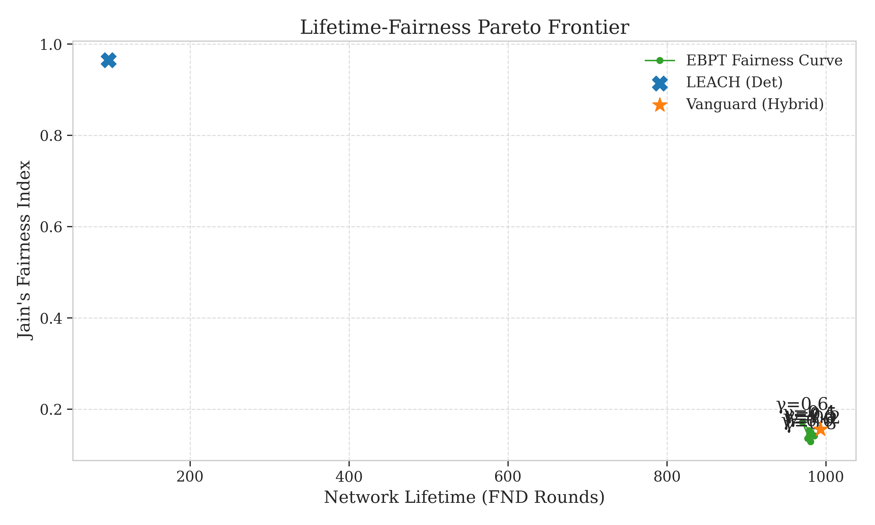
Beyond the Horizon: The AI-Driven Future
Future Scope: AI and Hardware Evolution
Self-Learning AI: Nodes that learn to manage workload autonomously.
Silicon Chips: Moving from Python scripts to physical hardware.
Targeting 99%: Using Reinforcement Learning for perfect Gamma tuning.
Smart Trade-offs: Optimizing life vs speed (Verified in Fig 4).
Multi-Objective Optimization (Fig 4)

Slide 16
Final Verdict: A Validated Standard
Summary: Replaced Luck with Mathematical Certainty
Breakthrough: Validated 10.21x (1,021%) lifetime extension.
Efficiency: Pushed performance to 92.1% of the physical limit.
Stability: Zero early-node death during the critical stable period.
Legacy: A new benchmark for reliable environmental monitoring.

Slide 17
Scientific Foundations: References
Scientific Foundations and Acknowledgments
Heinzelman et al. (2002): IEEE LEACH Protocol Foundations.
Younis & Fahmy (2004): IEEE HEED Hybrid Energy Efficiency.
Standard IEEE First-Order Radio Model (Simulated in Python).
Amrita Vishwa Vidyapeetham | Dept. of Mathematics.

